Slide 1
Sales Analysis
by Janmaya Kumar Jena

Slide 2
Contents :
Objectives
Overview Of Data
Monthly Sales & Monthly Order Quantity
Product Line Performance & Customer Performance
Country Wise & Territory wise Sales
Deal Wise Sales
Sales Analysis - Final Dashboard
Conclusion
Scope of Improvements

Slide 3
Objectives :
Create a dashboard with the following metrics
Monthly sales
Top 10 Products generating the highest revenue
Top 5 products which are being sold the most in quantity
Territory with the highest sales
Top 10 countries by highest sales
territory wise distribution of deal size
Distribution of order status by region

Slide 4
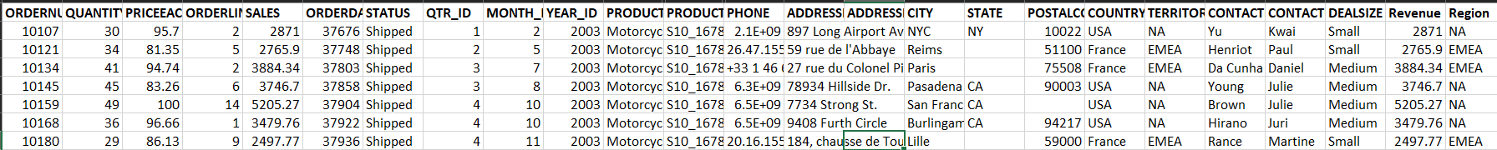
Overview Of Data:
Data Rows
Data Columns
Product Line
Countries
2824
27
07
20

Slide 5
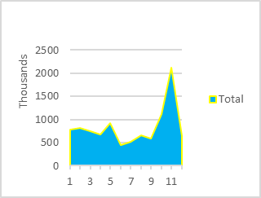
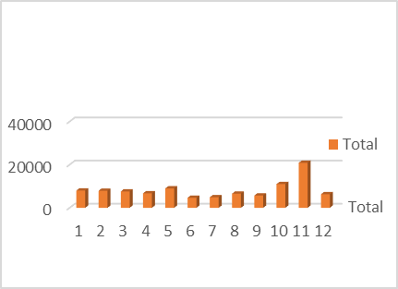
Monthly Sales & Monthly Order Quantity
2003 & 2004 years having the highest sales happened only in November month.
Company is growing YOY (Year on Year) based on the sales trend.
No. of orders also increasing YOY.
Observed more than 100% growth in 2004 while comparing 2003 year.
Monthly sales
Monthly Ordered Quantity

Slide 6
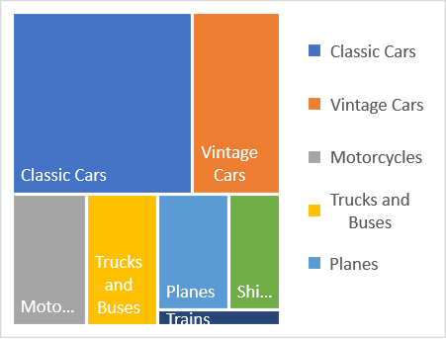
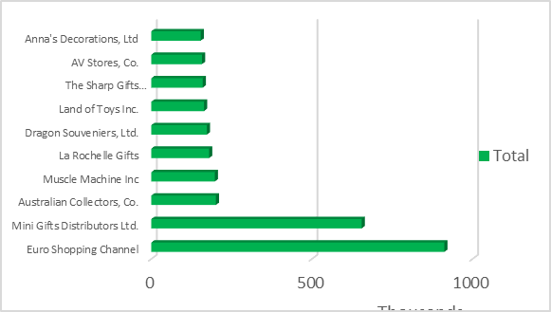
Product Line Performance & Customer Performance
Classic Cars have the highest Sales than other Product Line
Trains have the lowest sales than others.
More than 35% of Sales come from only Classic Cars.
Euro Shopping Channel is one of the best Customers coming in the Top 1.
On Second place occupied by Mini Gifts Distributors Ltd.
Product Performance
Customer Performance

Slide 7
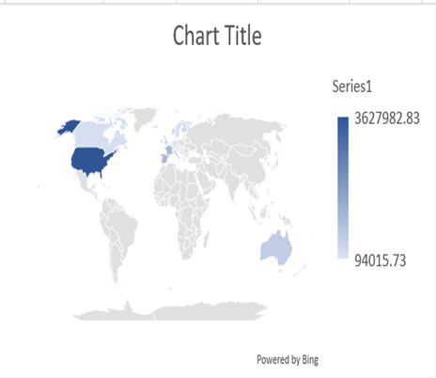
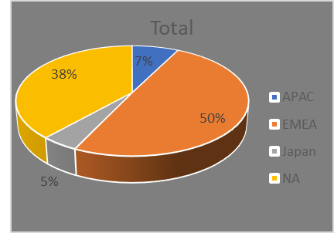
Country Wise & Territory wise Sales
Highest sales come from the USA then France in third Spain.
Philippines gives the lowest ever sales.
EMEA (Europe, Middle East, and Africa) Territory gives almost 50% of sales because TOP sales-performing countries come from this territory.
Japan has approximately 5% which is the Lowest Sales.
Country Wise Sales
Territory Wise Sales

Slide 8
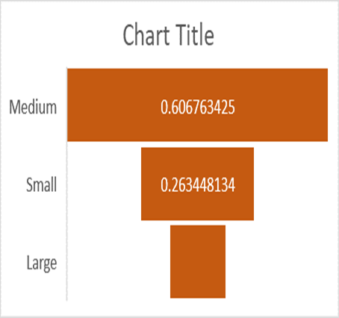
Deal Wise Sales
Medium deal lead towards the highest Sales then comes Small deals.
Large deals perform lowest compare to others.
Deal Size sales

Slide 9
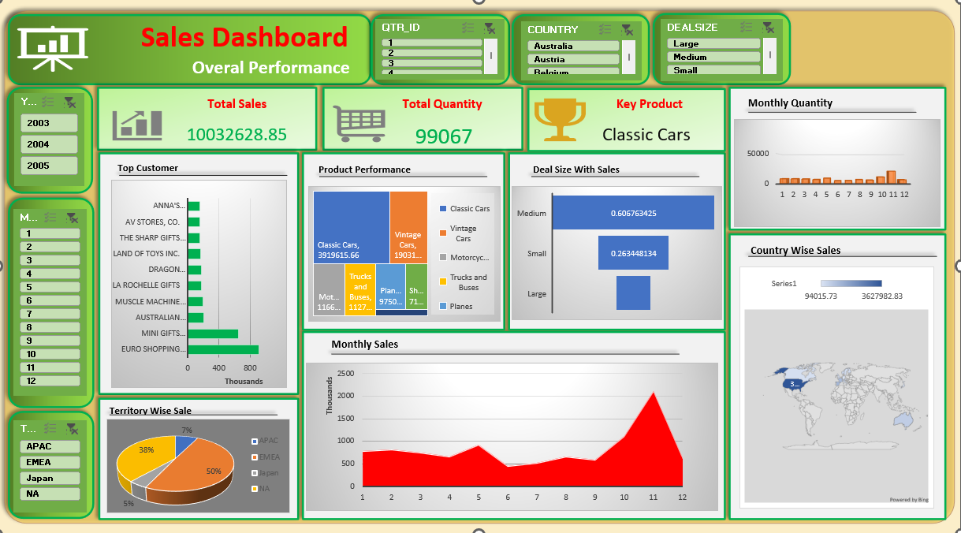
Sales Analysis - Final Dashboard

Slide 10
Conclusion
Company is growing YOY.
More than 100% growth happened on 2004
Classic Cars is the Key product here which has a direct impact on the Sales trend.
Most Classic Cars products are consumed in the USA and less in the Philippines.
Euro Shopping Channel is the all-time best Customer.

Slide 11
Scope of Improvements
Below are the fewer Sales performing countries company should focus on a priority basis.
Philippines
Germany
Sweden
Canada
Belgium
Trains, Ships, and Planes are the three Product Line that has fewer sales, So here Company needs to take immediate action to work on the products as well as understand the customer experience to grow up sales.

Slide 12


